Slide 1
Embedding-based Query Language Models
羅天宏

Slide 2
Outline
Embedding-based query model
Experiment
Result and Discussion

Slide 3
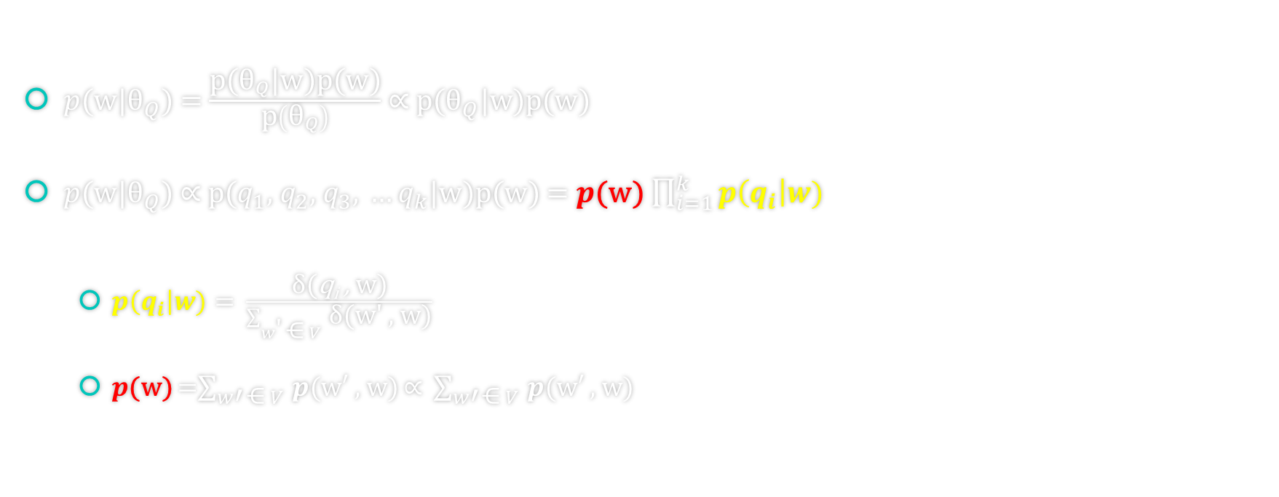
Conditional Independence of Query Terms
$p$(w|${\text{θ}}_{Q}$) = $\frac{\text{p}\text{(}{\text{θ}}_{Q}\text{|}\text{w}\text{)}\text{p}\text{(}\text{w}\text{)}}{\text{p}\left({\text{θ}}_{Q}\right)}$ ∝ $\text{p}\text{(}{\text{θ}}_{Q}\text{|}\text{w}\text{)}\text{p}\text{(}\text{w}\text{)}$
$p$(w|${\text{θ}}_{Q}$) ∝ $\text{p}\text{(}q_{1}\text{,} q_{2}\text{,} q_{3}\text{,} …q_{k}\text{|}\text{w}\text{)}\text{p}\text{(}\text{w}\text{)}$ = $p$(w) $\prod_{i=1}^{k}{p\left(q_{i}\right|w)}$
$p\left(q_{i}\right|w)$ = $\frac{\text{δ}\text{(}\text{q}\text{i} \text{, }\text{w}\text{)}}{\sum_{w\text{′ }\text{⋲} V }^{ }{\text{δ}\text{(}\text{w}\text{′}\text{ , }\text{w}\text{)}}}$
$p$(w) =$\sum_{w\text{′} \text{⋲} V }^{ }{p\text{(}\text{w}\text{′ , }\text{w}\text{)}}\text{∝} \sum_{w\text{′} \text{⋲} V }^{ }{p\text{(}\text{w}\text{′ , }\text{w}\text{)}}$

Slide 4
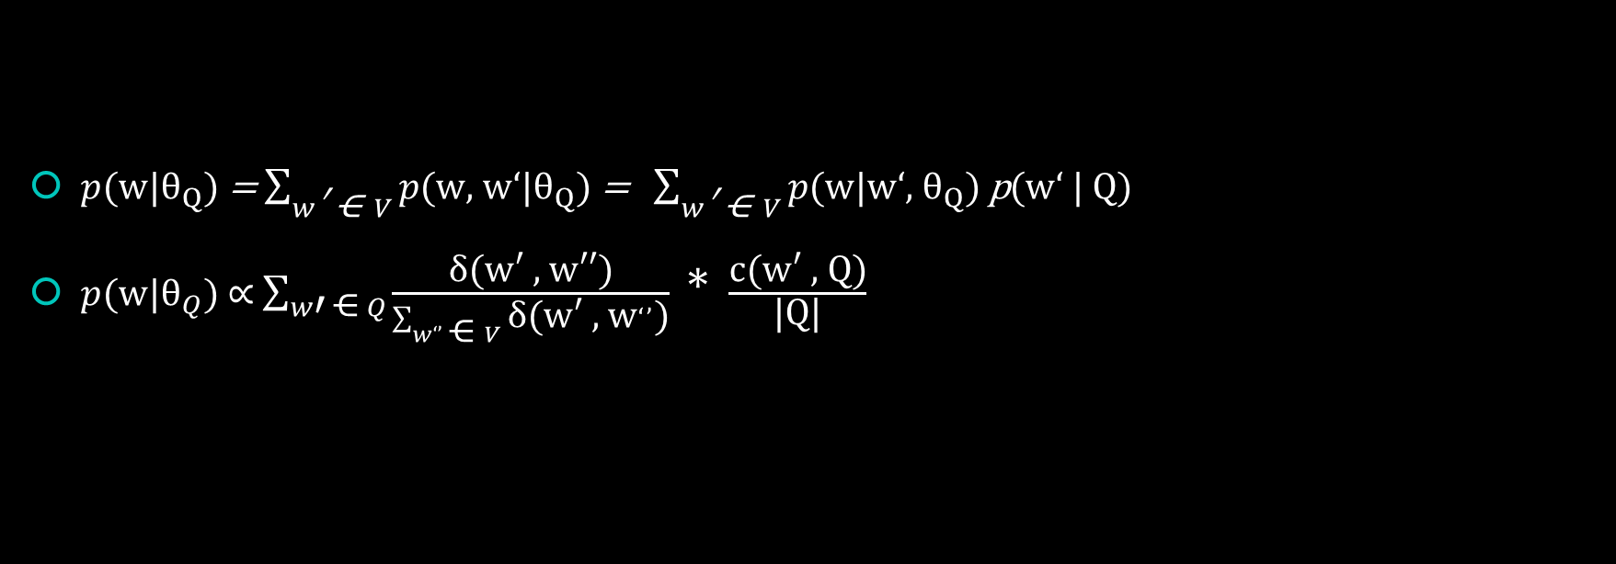
Query-Independent Term Similarities
$p$(w|${\text{θ}}_{Q}$) = $\sum_{w\text{′ ⋲} V}{p\text{(}\text{w}\text{, }\text{w}‘\text{|}{\text{θ}}_{Q}\text{)}}$ = $\sum_{w\text{′ ⋲} V}{p\text{(}\text{w}\text{|}\text{w}‘\text{, }{\text{θ}}_{Q}\text{)}}$ p($\text{w}‘$ | Q)
$p$(w|${\text{θ}}_{Q}$) ∝ $\sum_{w\text{′ ⋲} Q}{\frac{\text{δ}\text{(}\text{w}\text{′ , }\text{w}\text{′′)}}{\sum_{w‘’\text{ ⋲} V}^{ }{\text{δ}\text{(}\text{w}\text{′ , }\text{w}‘’\text{)}}}}$ * $\frac{\text{c}\text{(}\text{w}\text{′ , }\text{Q}\text{)}}{\text{|}\text{Q}\text{|}}$

Slide 5
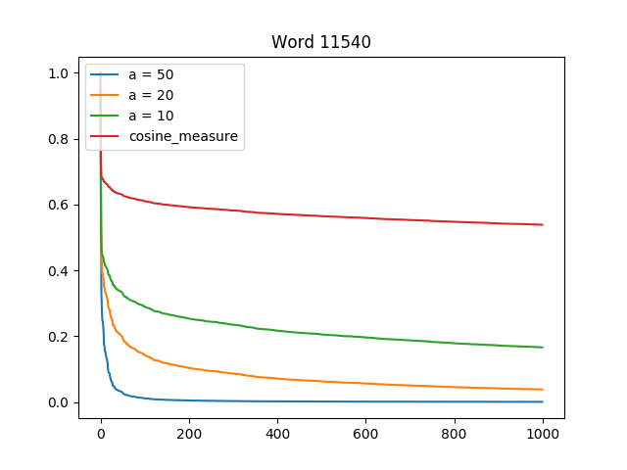
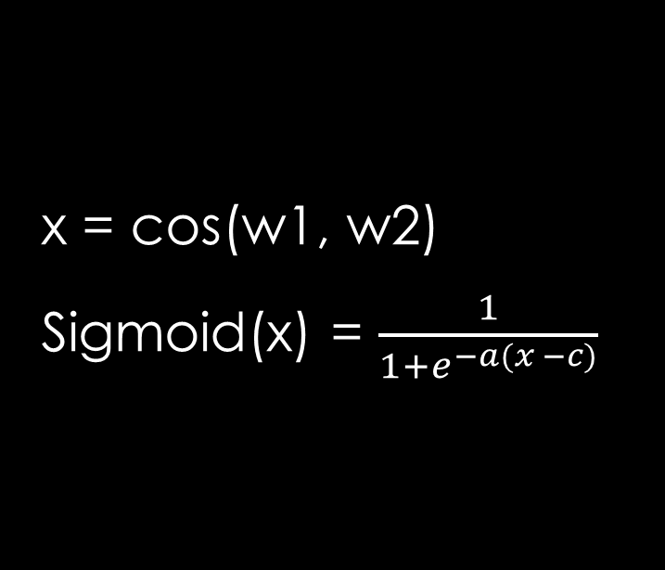
Similarity
x = cos(w1, w2)
Sigmoid(x) = $\frac{1}{1+e^{−a(x −c)}}$

Slide 6
Experiment
Word2Vec (gensim)
Parameter
a =10, 20, 30, 40, 50
c = 0.1, 0.2 …. 0.7
m = 1 ~ 80
Interpolated = 0.1, 0.2 … 1

Slide 7
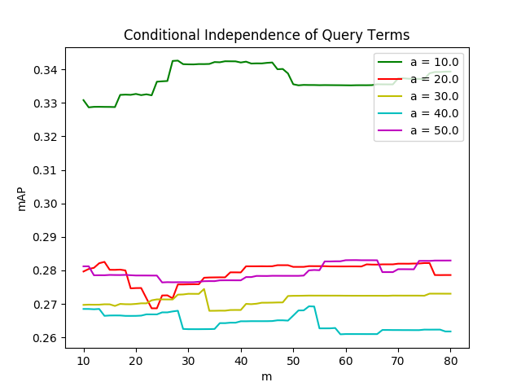
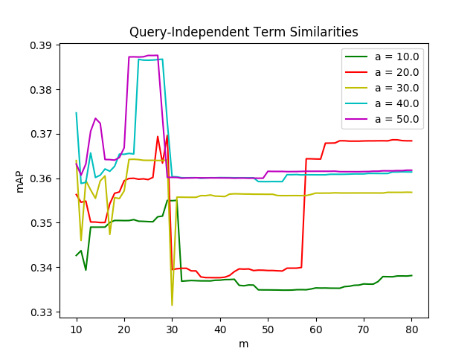
Results and Discussion
Performance of method with respect to the changes in the a(sigmoid value) and m(term count)

Slide 8
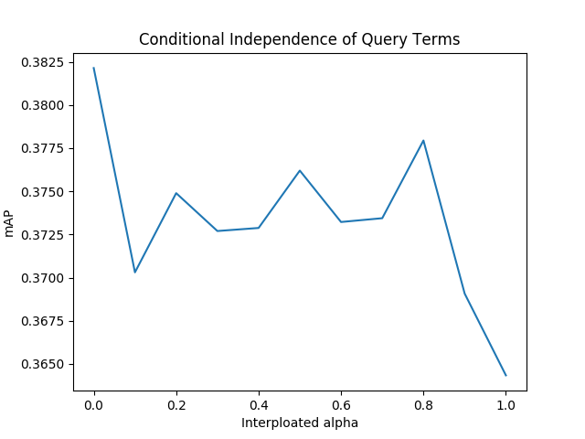
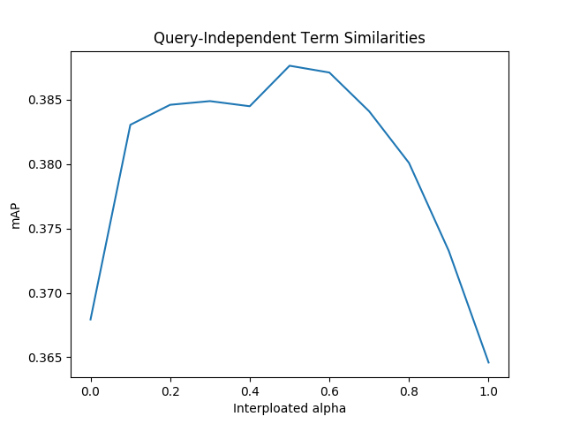
Results and Discussion

Slide 9
Results and Discussion
Conditional Independence of Query Terms
a = 10, c = 0.7, m= 1, interpolated alpha = 0
mAP = 0.382135586829
Query-Independent Term Similarities
a = 50, c = 0.7, m =27, interpolated alpha = 0.5
mAP = 0.387647331845

Slide 10
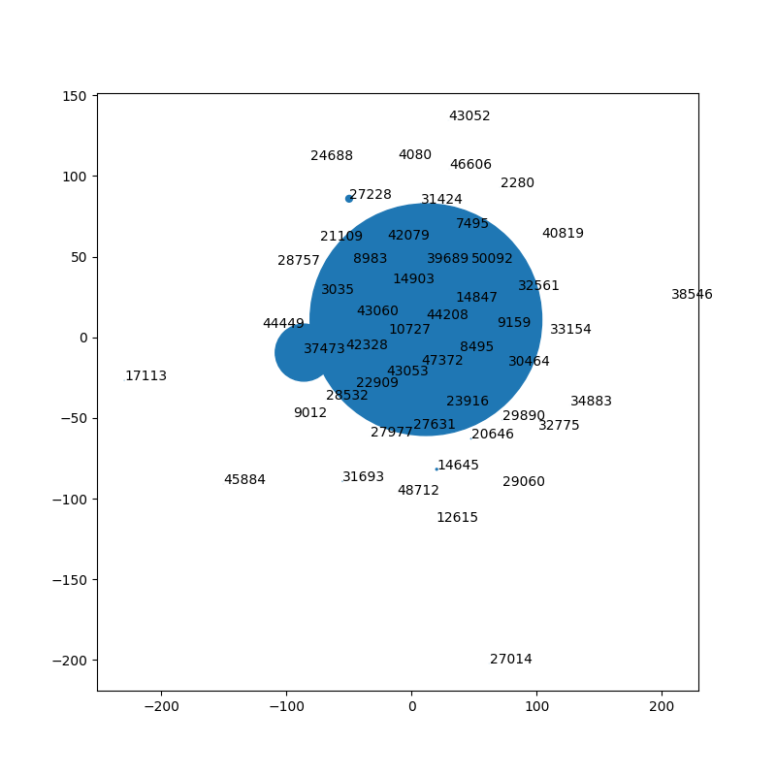
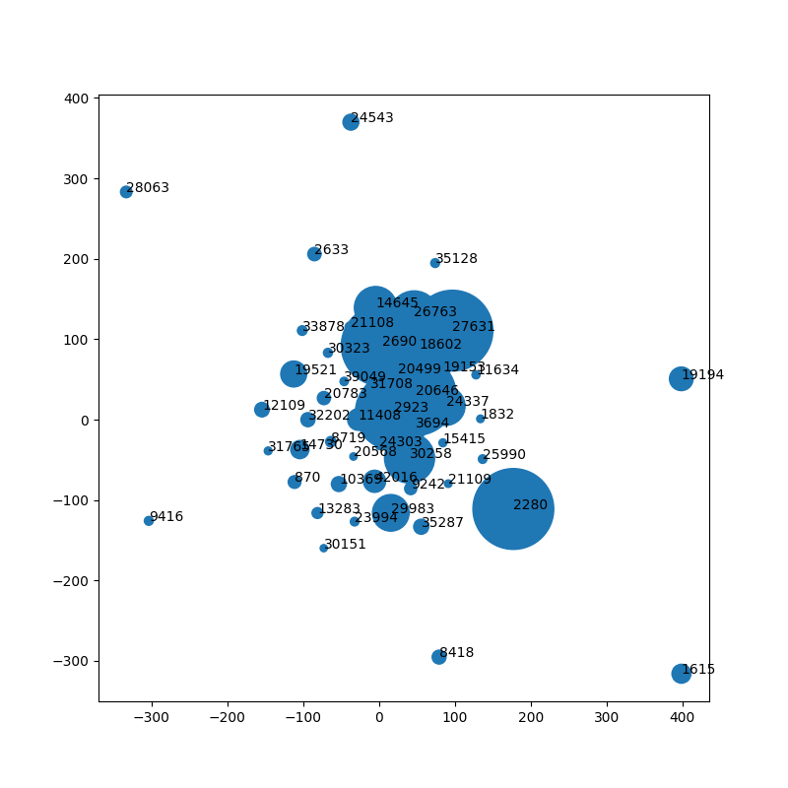
20001.query(a = 50)
visualize high-dimensional data(t-distributed Stochastic Neighbor Embedding)

Slide 11
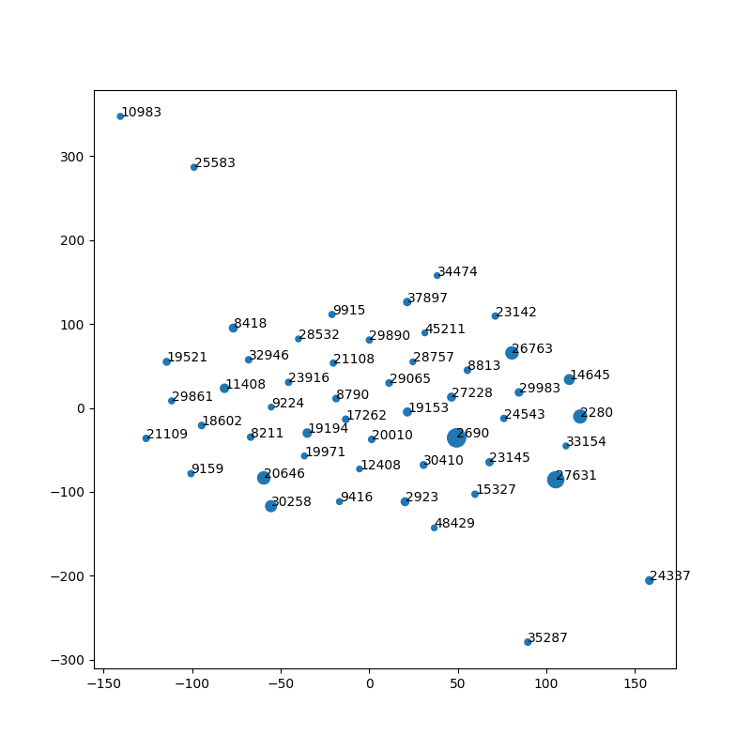
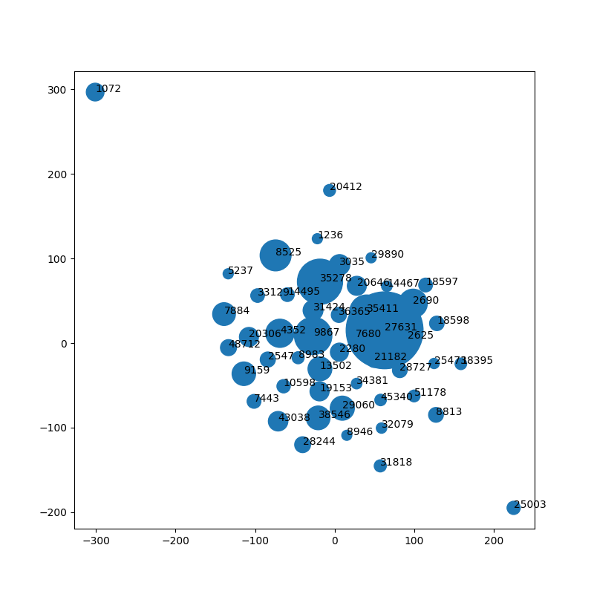
20001.query(a = 10)
visualize high-dimensional data(t-distributed Stochastic Neighbor Embedding)

Slide 12
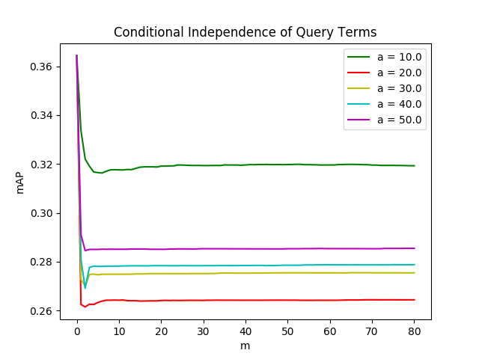
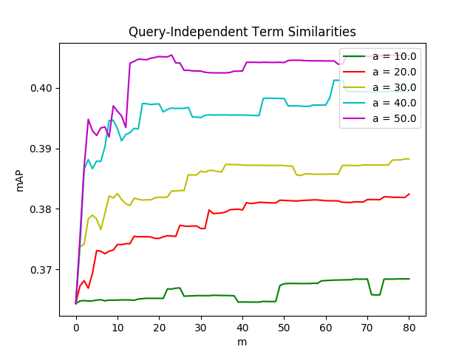
Results and Discussion
Performance of method with respect to the changes in the a(sigmoid value) and m(term count)

Slide 13
Results and Discussion
Conditional Independence of Query Terms
a = 10, c = 0.7, m = 0, interpolated alpha = 1
mAP = 0.364798195657
Query-Independent Term Similarities
a = 50 , c = 0.7, m = 23, interpolated alpha = 0.5
mAP = 0.405435353401

Slide 14
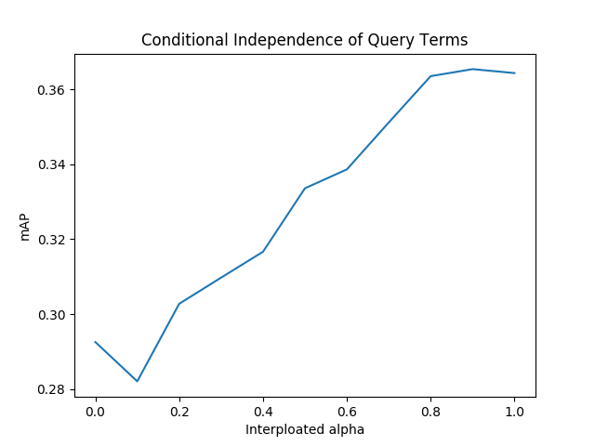
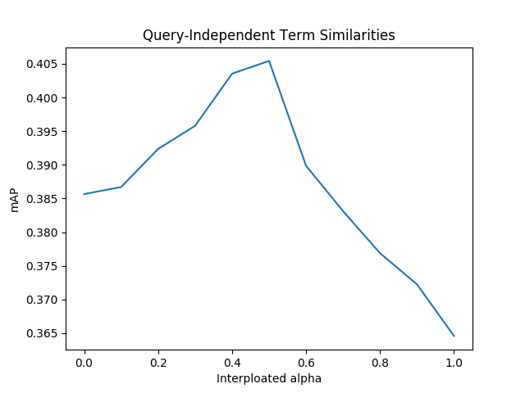
Results and Discussion

Slide 15
Results and Discussion
method | mAP
EQE1 | 0.382135586829
EQE2 | 0.387647331845
EQE1-nQT | 0.364798195657
EQE2-nQT | 0.405435353401

